Slide 1



European Processor Initiative
Mario Kovač, EPI Chief Communication Officer
mario.kovac@fer.hr
This project has received funding from the European Union’s Horizon 2020 research and innovation
programme under grant agreement No 101036168

Slide 2
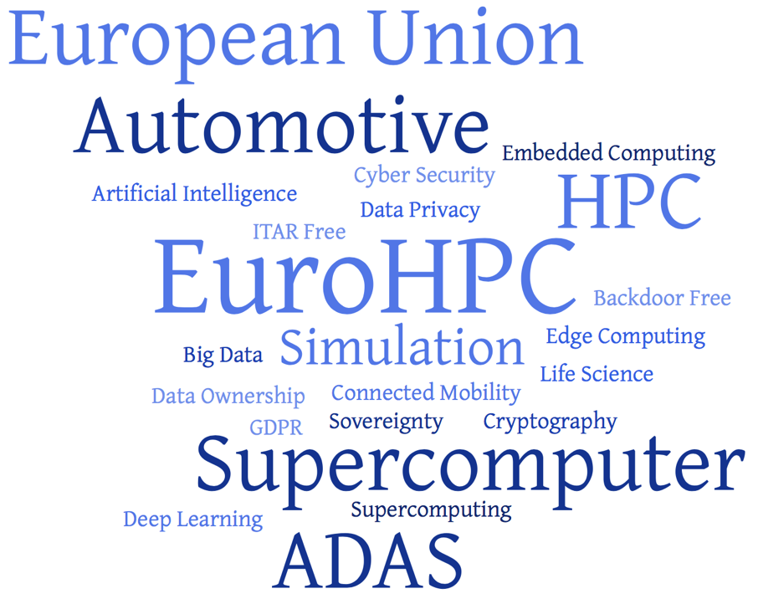
Space

Slide 3
The strategic INTERplay

Slide 4
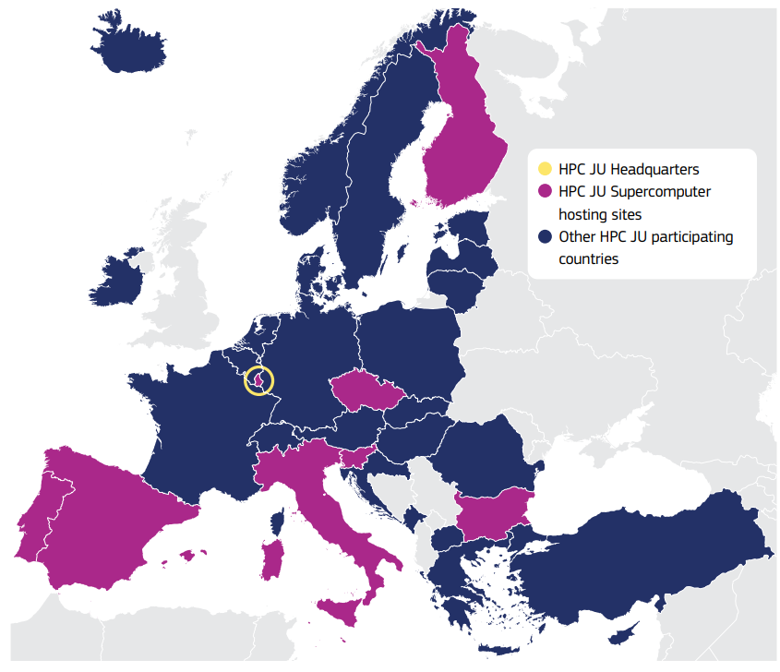

EU exascale HPC strategy
March 2017, Rome: EC launched the EuroHPC declaration
November 2018, EuroHPC Joint Undertaking, a 1 billion Euro joint initiative between the EU and European countries to develop a World Class Supercomputing Ecosystem in Europe
13.7.2021.: EU Council established new EuroHPC JU
  the 27 Member States, 6 other countries, 2 Private Members
  €7 billion investment

Slide 5
EuroHPC JU ambitious mission
Supercomputers
  reaching the next frontier of high-performance computing: the acquisition of exascale supercomputers
Interconnectivity
  interconnection through terabit networks of this supercomputing infrastructure, as well as in allowing access from the cloud to a large number of public and private users from anywhere in Europe
Applications for life
  further development of novel scientific and industrial applications
Skills and engagement with business
  increased investment in skills, education and training in the use of HPC, co-investment with industry in the acquisition of dedicated systems and in the development of large-scale industrial applications, creation of HPC Centres of Excellence
Technology activities
  the development of high-end European technologies, for example in the European Processor Initiative (EPI)

Slide 6


Slide 7

Drivers of the EPI Proposal
Societal challenges
Climate change
Cybersecurity
Increasing energy needs
Intensifying global competition
Aging population
Sovereignty (data, economical, embargo)
Image: https://www.compbiomed.eu/services/software-hub/

Slide 8


Slide 9

EPI PARTNERS

Slide 10

EPI objectives
Overall: Develop a complete EU designed high-end microprocessor, addressing Supercomputing and edge-HPC segments
Short-term objective
  supply the EU-designed microprocessor to empower the future Exascale machines
Long-term objective
  Europe needs a sovereign access to high-performance, low-power microprocessors, from IP to products
  contribute to the emergence of Risc-V as an open alternative to proprietary chip standards
  enable the emergence of an EU high-end processor industry (Arm & Risc-V based) that will have long term benefits

Slide 11
THE EPI TECHNOLOGY:
COMMON PLATFORM

Slide 12


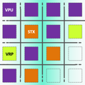
Gpp and common architecture
Neoverse
V1 cores
(ARM)
CCIX (RHEA)
CCIX & CXL (CRONOS)
PCIe gen5
links
external
links
Kalray
links
to adjacent chiplets
Dedicated cryptographic IP
EPI Common Platform open vision is to integrate most of EPI IP’s development
Neoverse
Neoverse
Neoverse
MPPA
ASIC
FPGA
Menta (FR)
Neoverse
Neoverse
Neoverse
EPAC
eFPGA
ASIC
HBM 2e
memories
Network on Chip (NoC) – ARM
CPU – ARM – Neoverse V1 Core
EPAC – EPI Accelerator
MPPA – Multi-Purpose Processing Array
eFPGA – embedded FPGA
Cryptographic ASIC (EU Sovereignty)
Any other ASIC
NoC
ARM
DDR5
memories
Notes:
Good news for research projects

Slide 13
THE EPI TECHNOLOGY:
ACCELERATORS

Slide 14
TOP10 (Green) over the last 10 years
 | 2009 – Nov. | 2014 – Nov. | 2020 – Nov. | 2021 – Nov.
CPU only | 9 | 5 | 2 | 0
CPU + ACC. | 1 | 5 | 8 | 10

Slide 15
EPAC – RISC-V Accelerator foundations
EPAC
VPU
Bridge to GPP
STX
EPAC - EPI Accelerator
VPU - Vector Processing Unit
STX - Stencil/Tensor accelerator
VRP - VaRiable Precision co-processor
VRP
Bridge to GPP
Notes:
Good news for research projects

Slide 16
EPAC1.0
EPAC test chip combines several accelerator technologies specialized for different application areas:
  four vector processing micro-tiles (VPU) composed of an Avispado RISC-V core designed by SemiDynamics and a vector processing unit designed by Barcelona Supercomputing Center and the University of Zagreb
  Home Node and L2 cache, designed respectively by Chalmers and FORTH
  two additional accelerators:
    the Stencil and Tensor accelerator (STX) designed by Fraunhofer IIS, ITWM and ETH Zürich
    variable precision processor (VRP) by CEA LIST
  All accelerators on the chip are connected with a very high-speed network on chip and SERDES technology from EXTOLL.

Slide 17
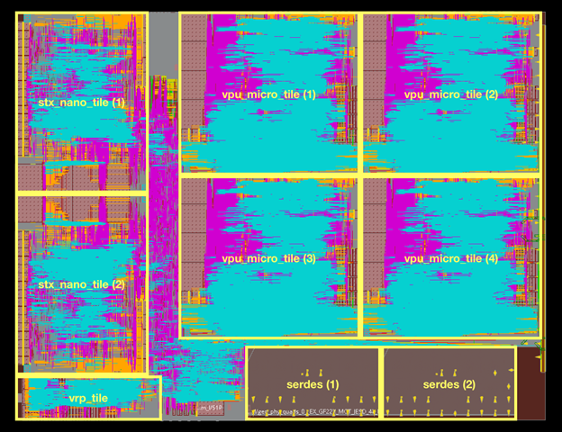
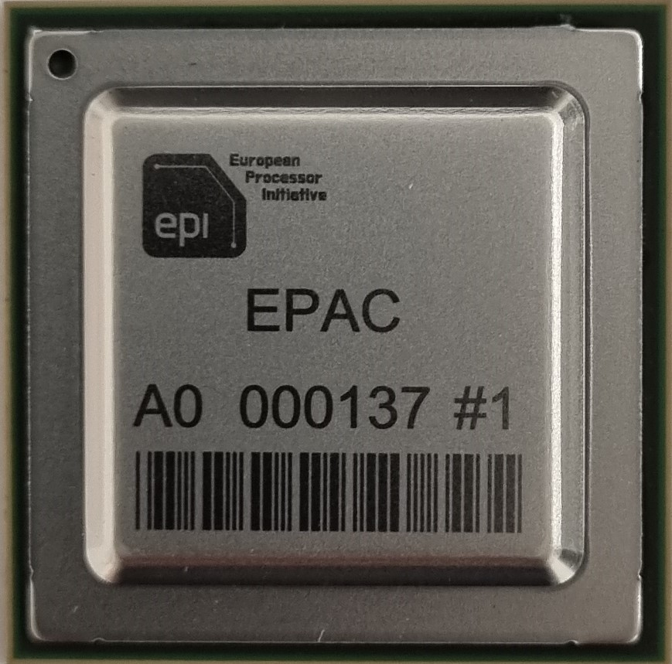
EPAC 1.0

Slide 18
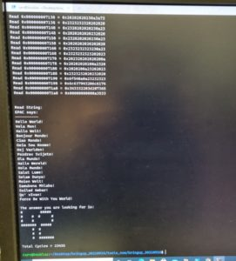
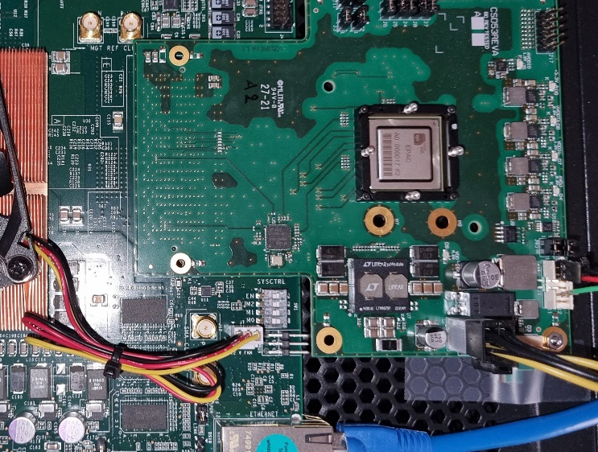
And the “hello world” in EU languages

Slide 19
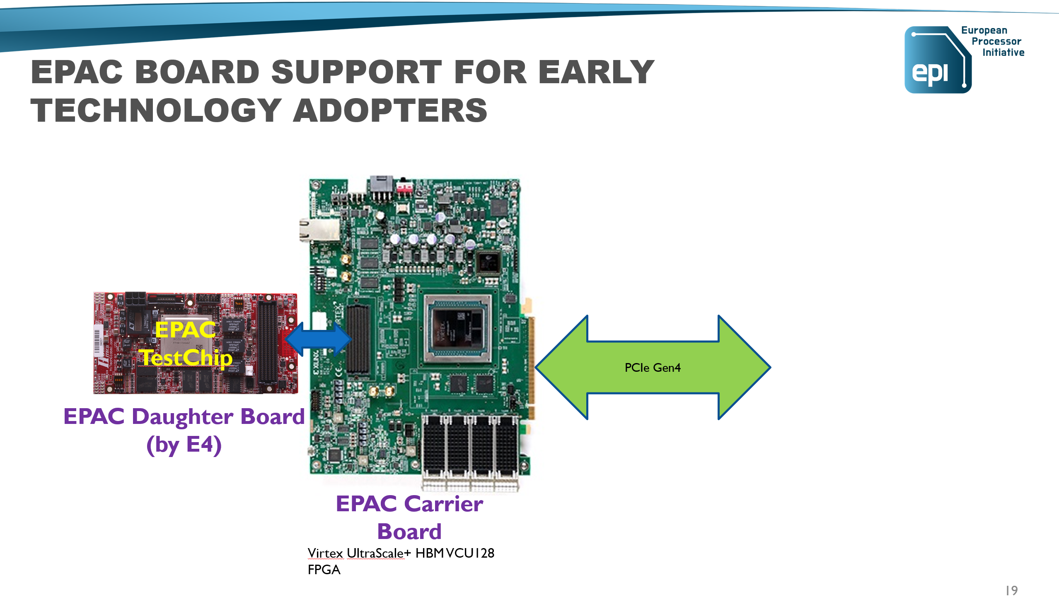
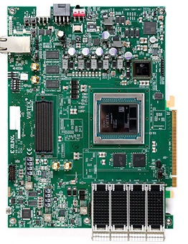
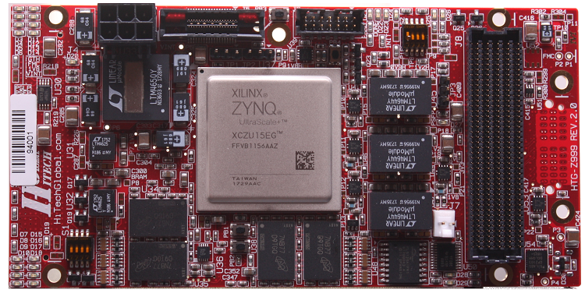
EPAC Board support
EPAC
TestChip
PCIe Gen4
EPAC Daughter Board
(by E4)
EPAC Carrier Board
Virtex UltraScale+ HBM VCU128 FPGA

Slide 20
EPI Phase2

Slide 21
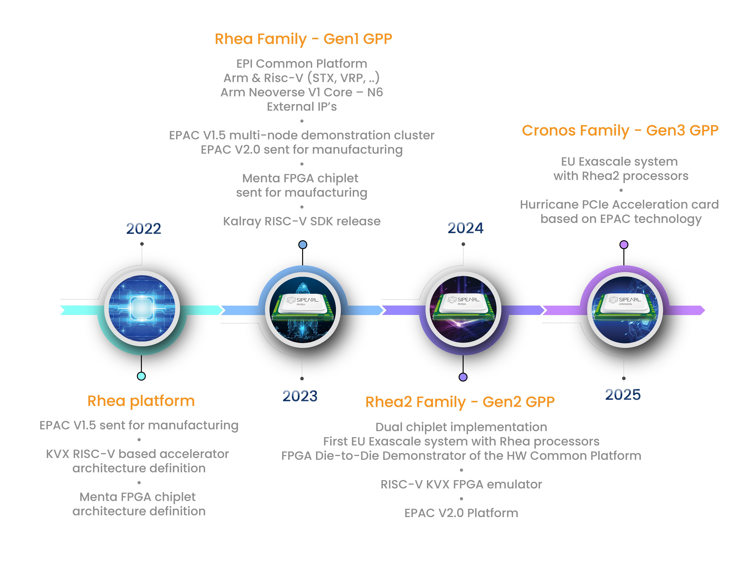
EPI2 ROADMAP

Slide 22
Expected outcomes
We expect, at the end of our second phase, to have
  The first generation of our GPP validated & exposed to customers
  The second generation of our GPP designed
  Several flavours and versions of Risc-V accelerators developed and tested, for instance EPAC 1.5 & 2.0 test chips
and, as indirect outcomes,
  developed and validated systems that integrate that GPP into data centres
  contributed to the emergence of Risc-V as an open alternative to proprietary chip standards
  enabled the emergence of an EU high-end processor industry (Arm & Risc-V based) that will have long term benefits

Slide 23




EPI conclusion
Use of HPC and AI is cornerstone of successful address of societal and global challenges
Future science, technologies and applications require processing of vast amount of data and there is a large need for efficient HPC
HPC provides needed competitiveness for industry and society
The expertise for developing high-end and complex processing units in Europe, after decades of dis-investment
The European Processor Initiative aims to provide an EU HPC processor, accelerators and system/application design for exascale HPC systems in Europe and around the globe
w
www.european-processor-initiative.eu
@EuProcessor
European Processor Initiative
European Processor Initiative

Slide 24
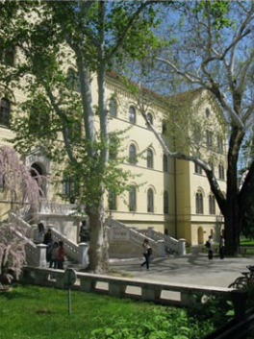
University of Zagreb
  Founded in 1669
  29 Faculties, 3 Academies
  approx. 70,000 students
  167 Undergraduate Programs
  21 Integrated Programs
  182 Graduate Programs
  66 Doctoral Programs
  146 Postgraduate Specialist Programs
  Studnets enrolled in the 1st year of study:11,500
  PhD degrees:400 / year

Slide 25
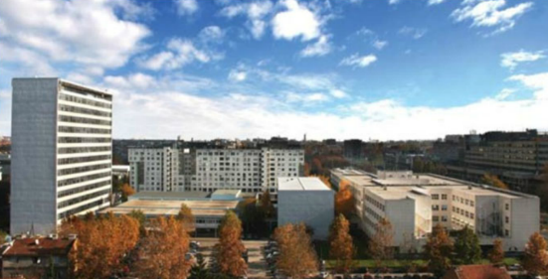
Faculty of Electrical Engineering and Computing (FER)
~ 650 employees
12 departments
4000 students
450 PhD students
Bachelor & Master Study Programs:
  Electrical Engineering and Information Technology
  Information and Communication Technology
  Computing
PhD Programs:
  Electrical Engineering
  Computing

Slide 26
HPC Architectures and Applications Research Center @ FER
GPP/Accelerator architecture
FAUST – our Risc-V pipelined vector FPU
  Implemented in EPAC VPU
Risc-V based accelerators
  SA
Imaging apps/optimisations
  Bolt65
  Jaguar

Slide 27
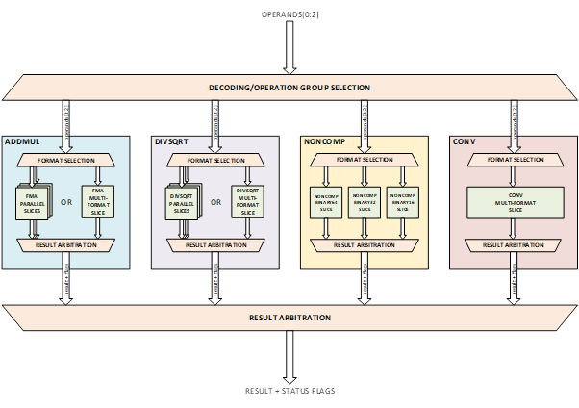
FAUST – Risc-V pipelined vector fpu
Compliance with IEEE 754-2019 Standard
  Only minor deviation
Supported all floating-point operations defined in RISC-V ISA
  RVV 1.0: all operations except reciprocal estimate operations
Floating-point formats
  binary16 (half precision format)
  binary32 (single precision format)
  binary64 (double precision format)
Rounding modes
  Round to nearest, ties to even
  Round to nearest, ties to max magnitude
  Round up
  Round down
  Round towards zero
Supported all IEEE 754 status flags
  Invalid operation
  Divide by zero
  Overflow
  Underflow
  Inexact
Supported subnormal numbers
Support for vector unit integration
  Masking support
  Handshake interface for data flow control to and from the floating-point unit
Parameterized design: configurable architecture and pipeline stages

Slide 28
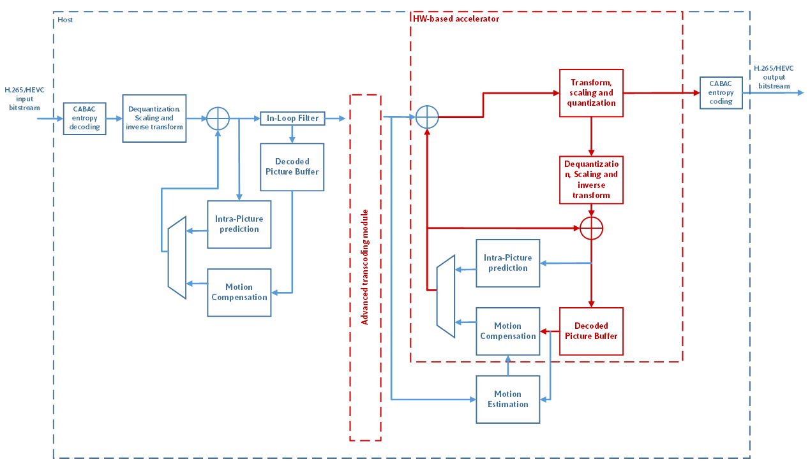
BOLT65
Bolt65 is a HEVC/H.265 hardware/software suite
  focus on Just-in-Time video processing
    constrainted by processing time
  clean room project created on FER - UNIZG
  consists of encoder, decoder, transcoder
Portability
  written in C++
  compiled and executed on ARM and x86
  can be compiled for Linux and Windows
  no external libraries used
Optimizations
  Partially optimized for AVX, SVE, NEON
  Custom accelerator and GPU support

Slide 29
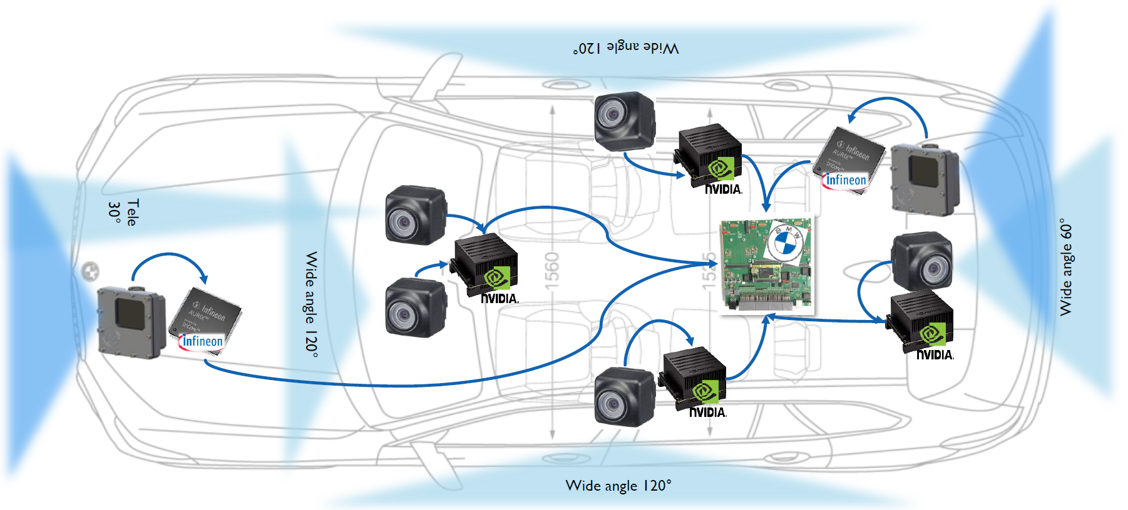
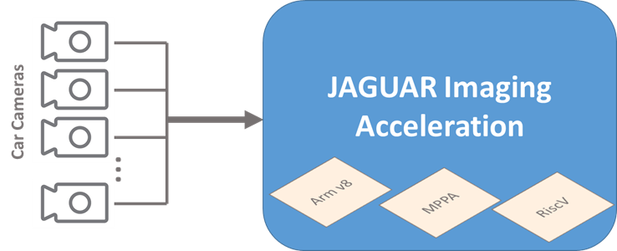
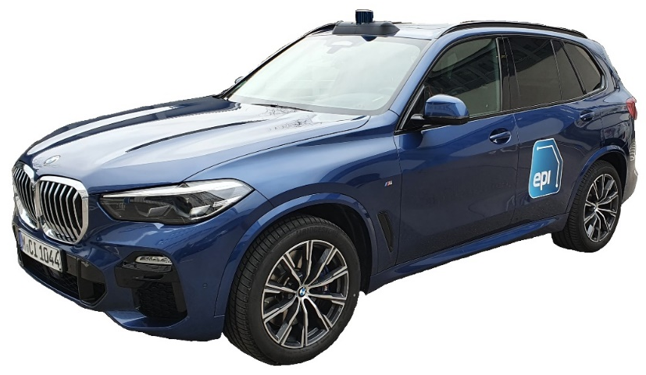
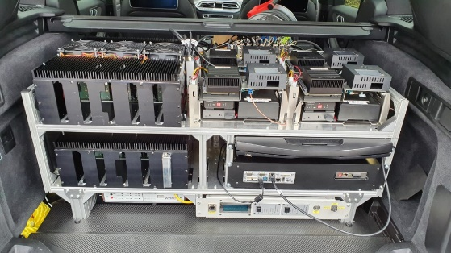
JAGUAR
Jaguar Imaging and AI Framework
  8/12-bit JPEG image codec
  SW/HW accelerator kernels

Slide 30
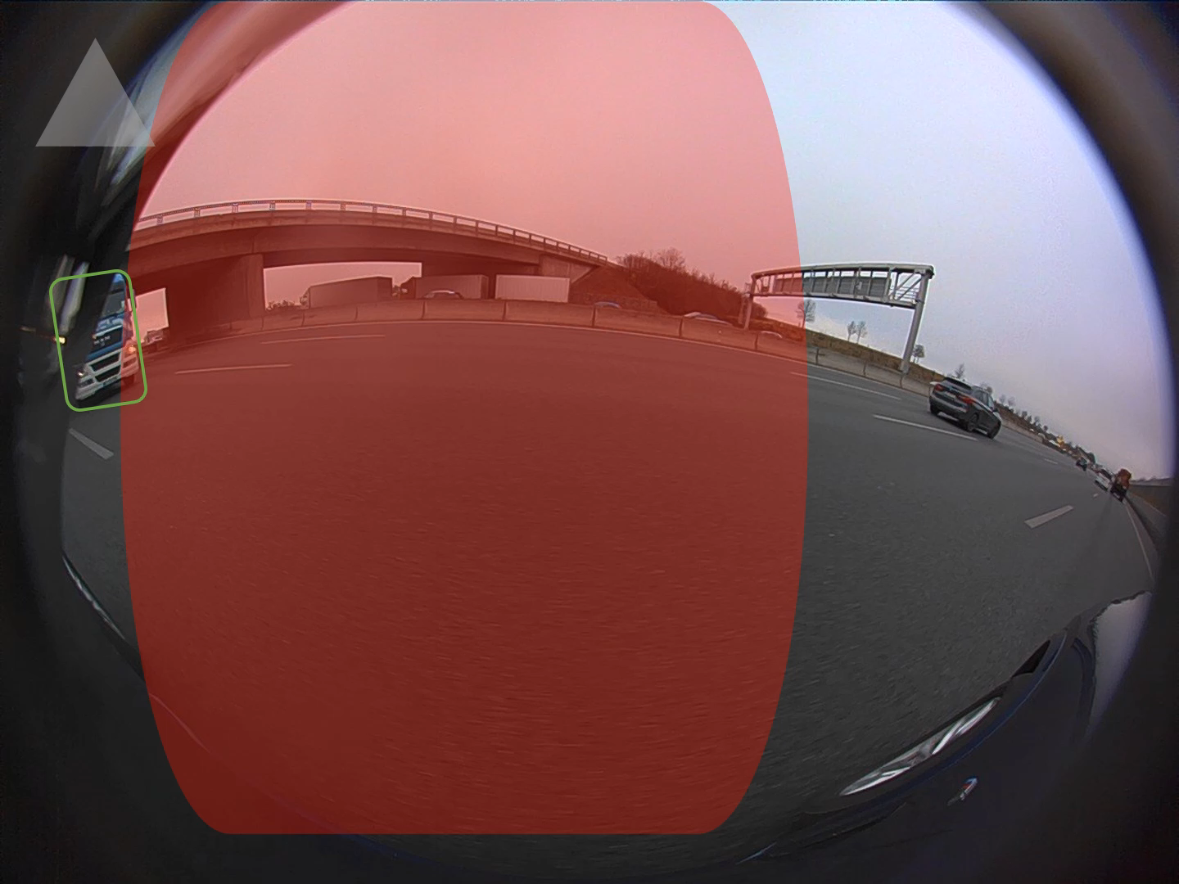
REAL CAR DRIVING detection results
Blind spot detection area
Blind spot alert
Detected moving object

Slide 31
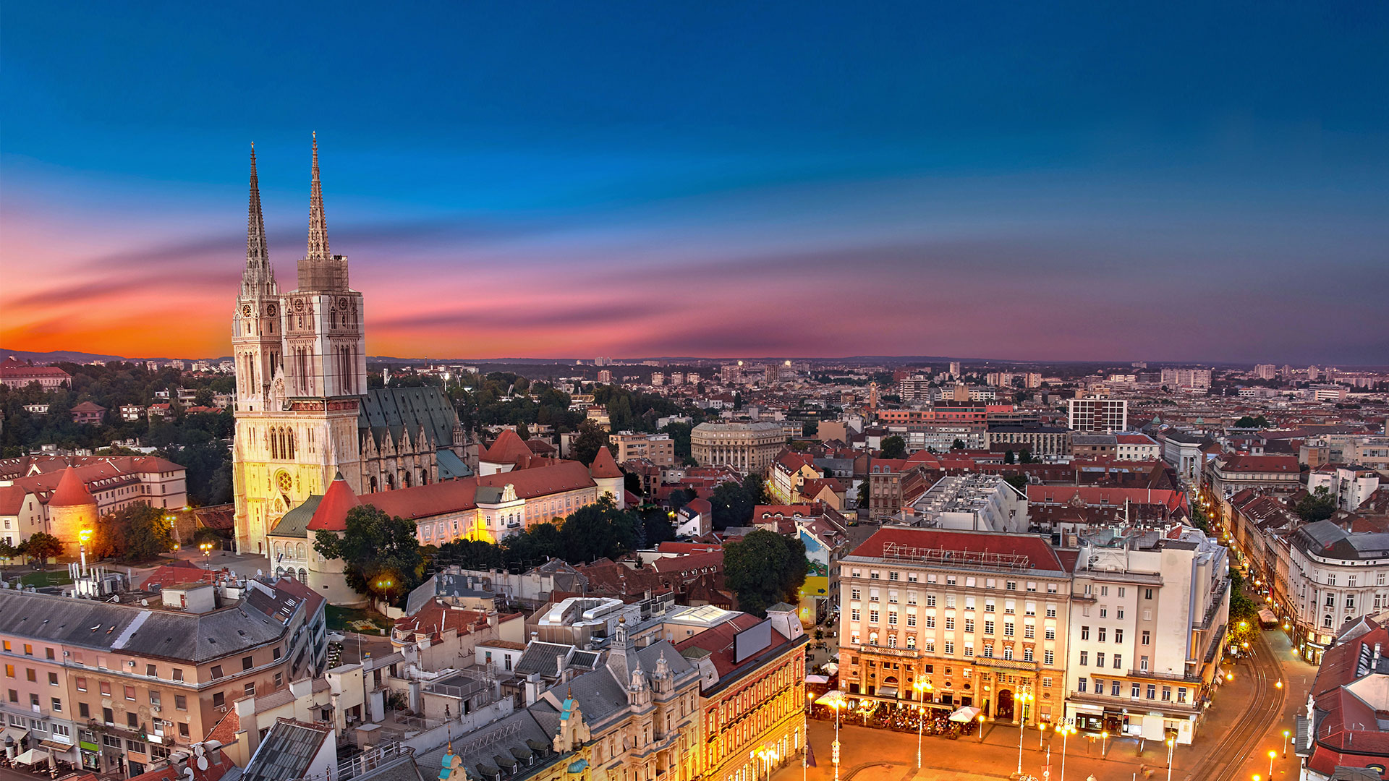
UNIZG - UBA possible areas of collaboration
The Agreement between Ministries of science Argentina and Croatia was signed…

Slide 32
Thank you for your attention
Copyright © European Processor Initiative 2021. CPS&IoT’2021
32

